Slide 1
Sprint 04
Team 01

Slide 2
Overview
Team Roles
Sprint 04 Goals
Task Difficulty Breakdown
Live Kanban Board Review
Demo’s (Cloud, Site, Team)
Completed Task Summary
Tasks Pushed
Summary
Conclusion

Slide 3
Team Roles
Project Manager: Greg Eure
IT Orchestration and Security: Armani Lesure
Developer: Tenzin Choeying
Developer: Phallyn Habercoss
Developer: Drew Snarski

Slide 4
Sprint 04 Goals
Integrate deployment to the required cloud environment (required)
Pre-populate the database (required)
Update the ERD to meet Django requirements
Modify the website look & feel to match the UI/UX design
Secure the MariaDB database and implement Fail2Ban intrusion detection

Slide 5
Task Difficulty Points Breakdown
Cloud environment integration/deployment: 5 points
Implement database security: 1 point
Implement Fail2Ban intrusion detection: 1 point
Prepopulate test users & q/a: 1 point
Export/import database containing pre-population: 2 points
Modify ERD to match actual database (after Django modifications): 2 points
Modify home page to match UI/UX: 5 points
Modify profile page to match UI/UX: 5 points
Modify question/answer page to match UI/UX: 3 points
Total: 25 points

Slide 6
Live Kanban Board Review

Slide 7
Live Cloud Deployment Demo

Slide 8
Live Site Demo

Slide 9
Team Member Demos

Slide 10
Completed Tasks
Cloud environment integration with existing scripts and deployment of same
Pre-populated the database with 5 test users and required sets of questions/answers
Home page function & design
Resolved design (color, positioning) issues, altered some text
Corrected menu functions to work correctly
User profile page functionality
Needed Admin to create profile (can this be linked to user registration in next sprint?)
Button functionality corrected (previously didn’t work)
Question/Answer function & design
Resolved design (color, positioning) issues, altered some text
Created Cancel function (button)
Updated the ERD

Slide 11
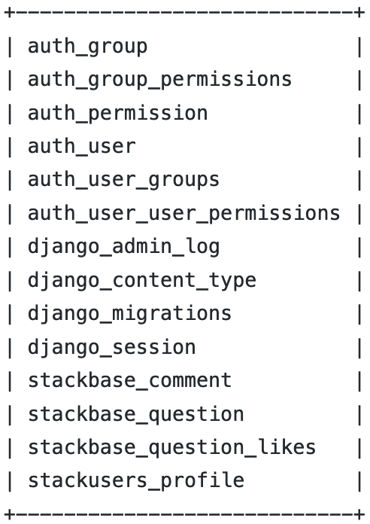
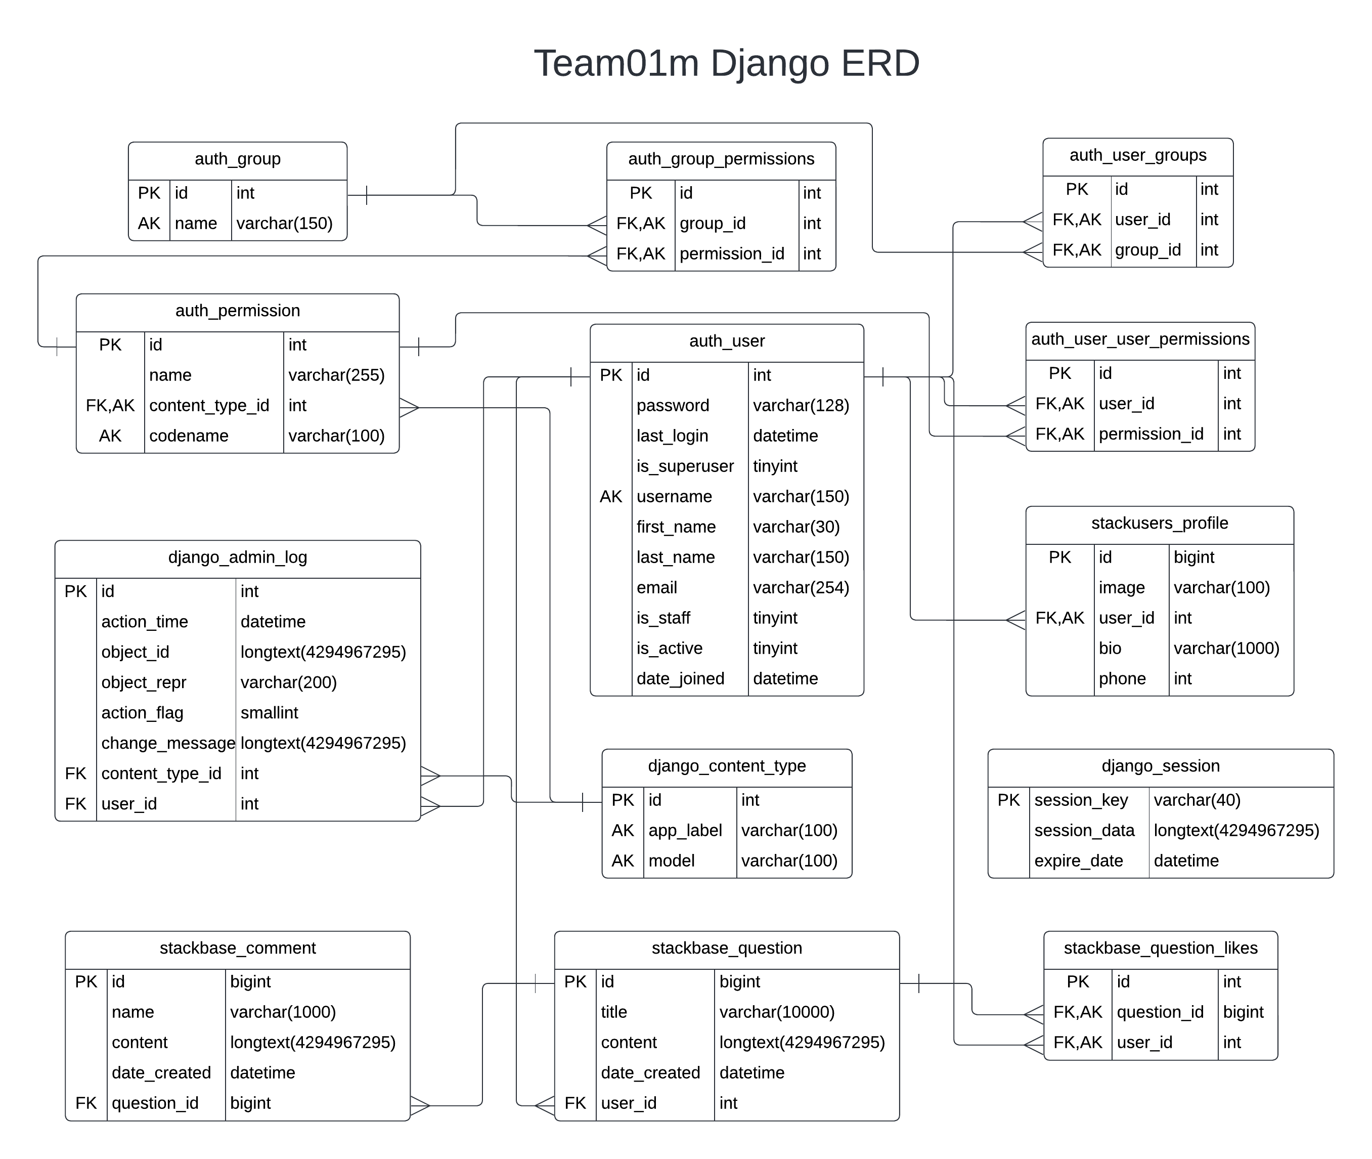
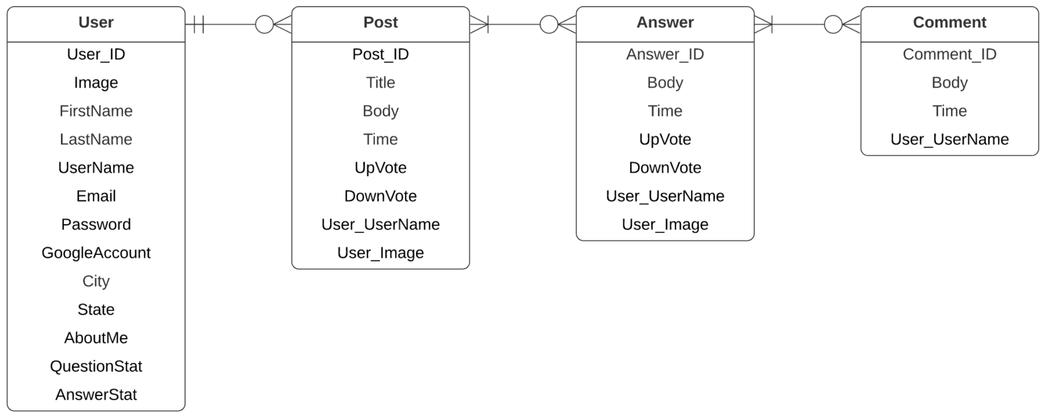
Completed Tasks: ERD Update

Slide 12
Tasks not Completed (Pushed to next Sprint)
Implement database security
Implement Fail2Ban intrusion detection

Slide 13
Summary
Team Roles
Sprint 04 Goals & Points Breakdown
Kanban Board Review
Cloud & Website Demo’s
Completed/Uncompleted Task Review

Slide 14
Conclusion / Lessons-Learned
Cloud integration was challenging, requiring lots of troubleshooting/problem isolation.
Lesson-learned: start early as this task takes several days
Lesson-learned: don’t hard-code IP’s in the scripts or config files
Some tasks may take collaboration across the team to resolve
Lesson-learned: lean on your teammates for their expertise and insights; escalate issues before they become problems

Slide 15
Task Overview: Database Security & Fail2Ban
Database Security
Implement MariaDB built-in mysql_secure_installation script, using silent installation methods
Basic security measure to prevent unauthorized database intrusions
Fail2Ban
Open-source intrusion detection software
Attempts to prevent intrusions by identifying failed login attempts and banning the associated IP addresses via dynamic firewall rules

